Slide 1
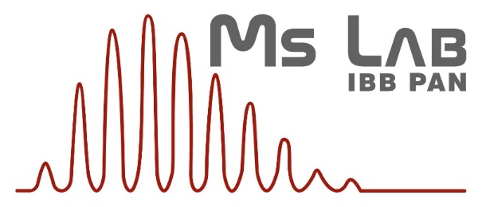
Mass Spectrometry Laboratory, IBB PAS
Impact of Team-Tech Core facility grant 2015-2021
Operating since Jan,2001
19.12.2022
Michał Dadlez
Head of Mass Spectrometry Laboratory
Institute of Biochemistry and Biophysics Polish Academy of Sciences
Web page: http://mslab-ibb.pl/en/

Slide 2
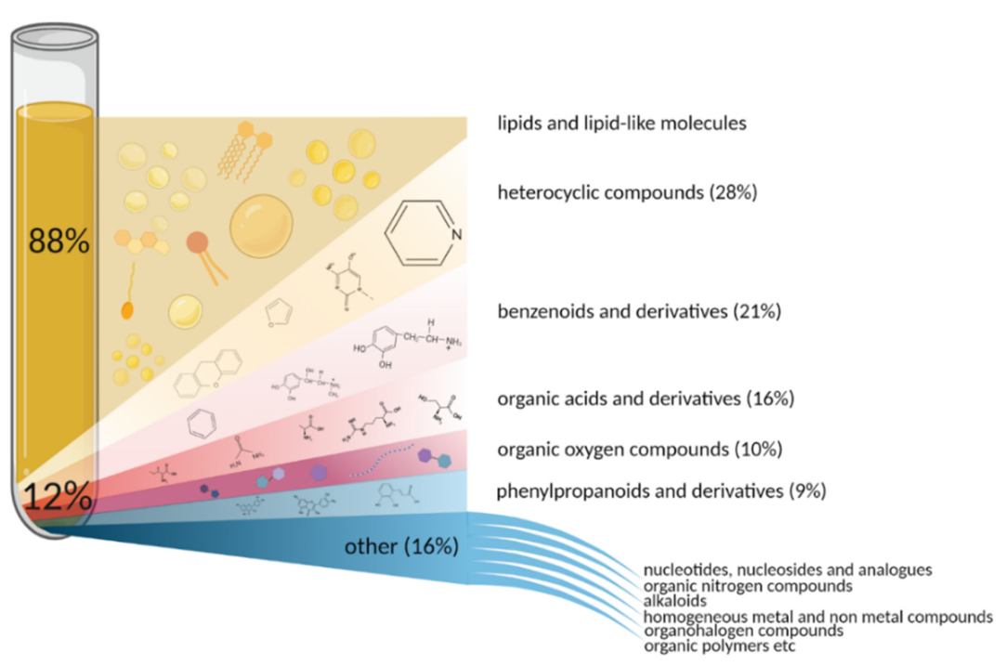
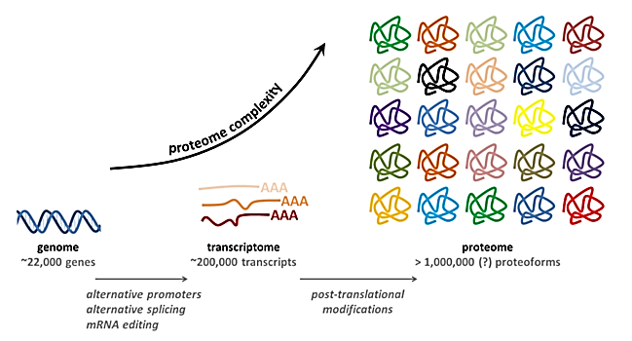
Proteomics & Metabolomics
Mass Spectrometry (MS)- based proteomics/metabolomics are a large-scale studies of proteins/small molecules (qualitative & quantitation – relative and absolute, global and targeted)
Metabolomics includes pharmacodynamics/kinetics for drug development, drug monitoring for medicine and drug metabolite analysis for personalised therapy
Structural MS provides structure/dynamics insight for difficult protein systems
& metabolome
https://www.proteomicscenter.nl/

Slide 3
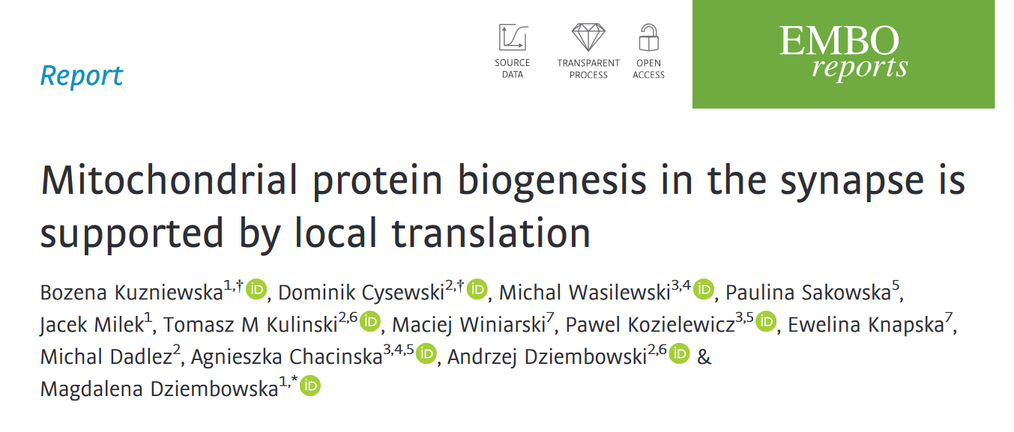
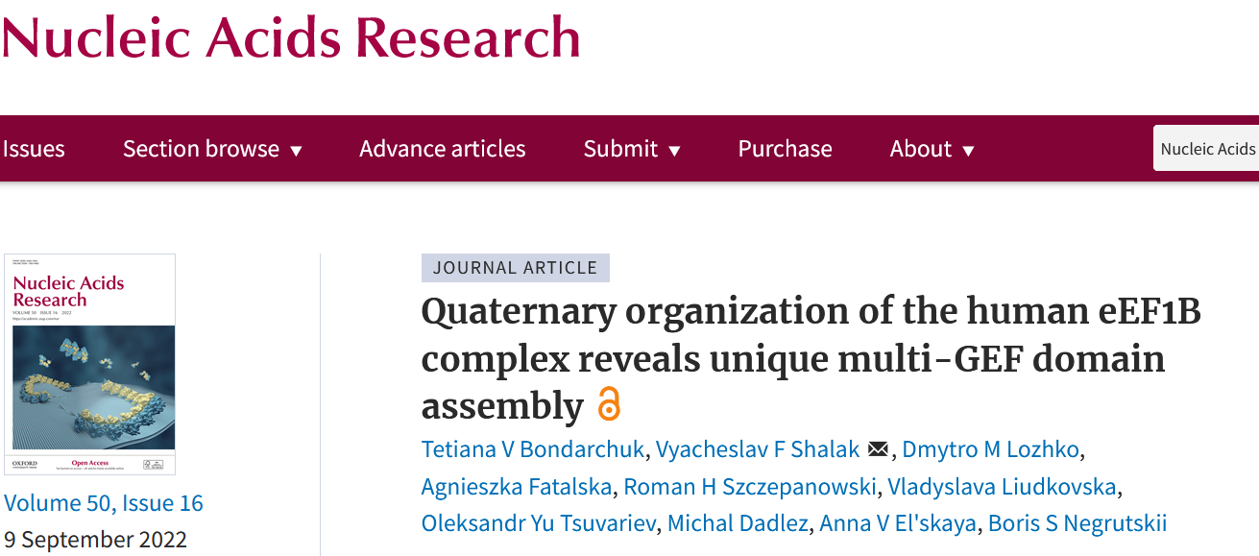
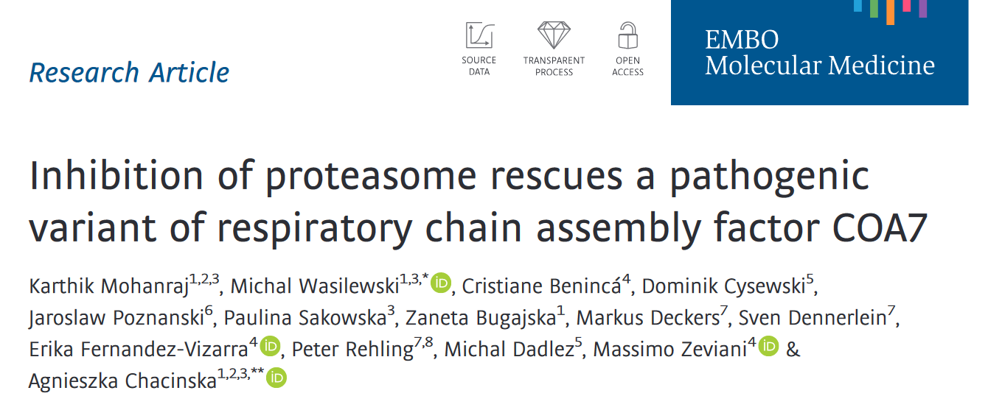
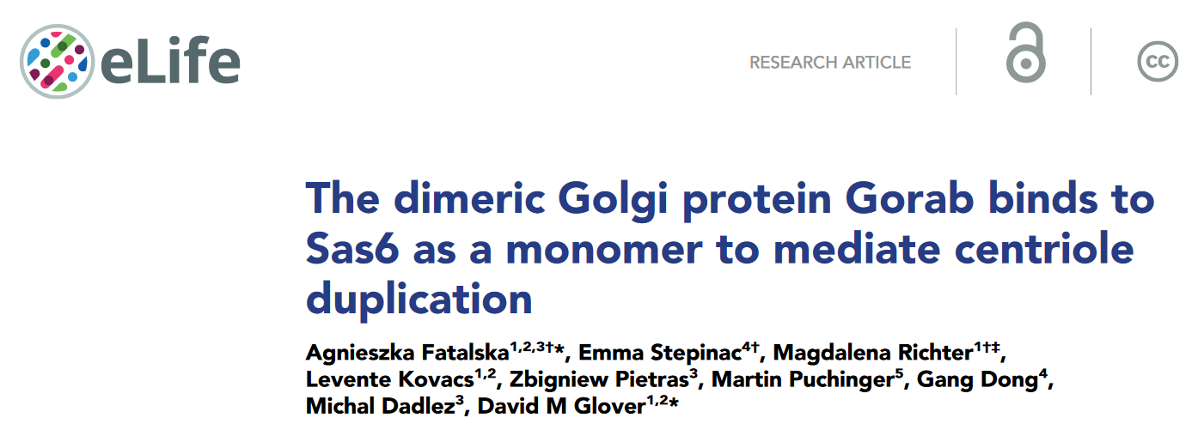
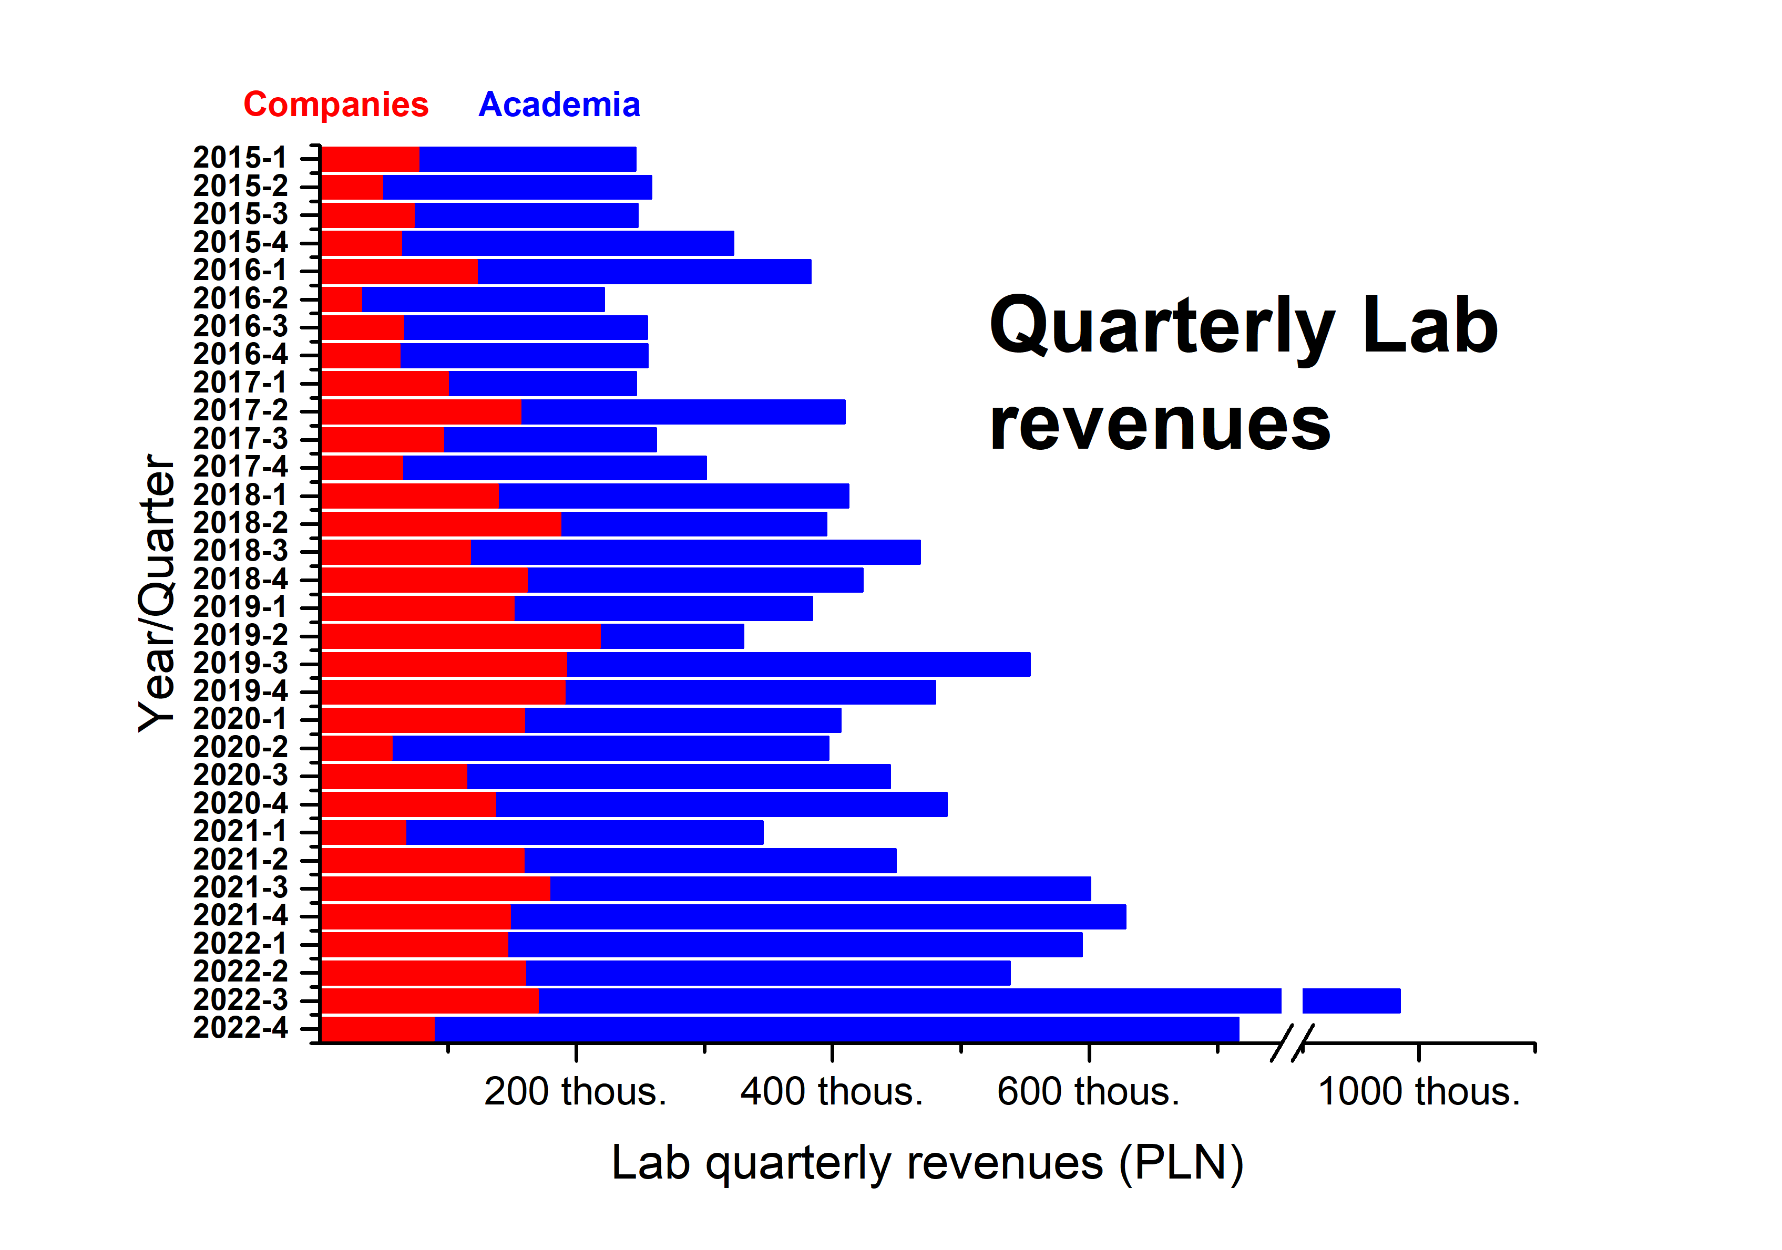
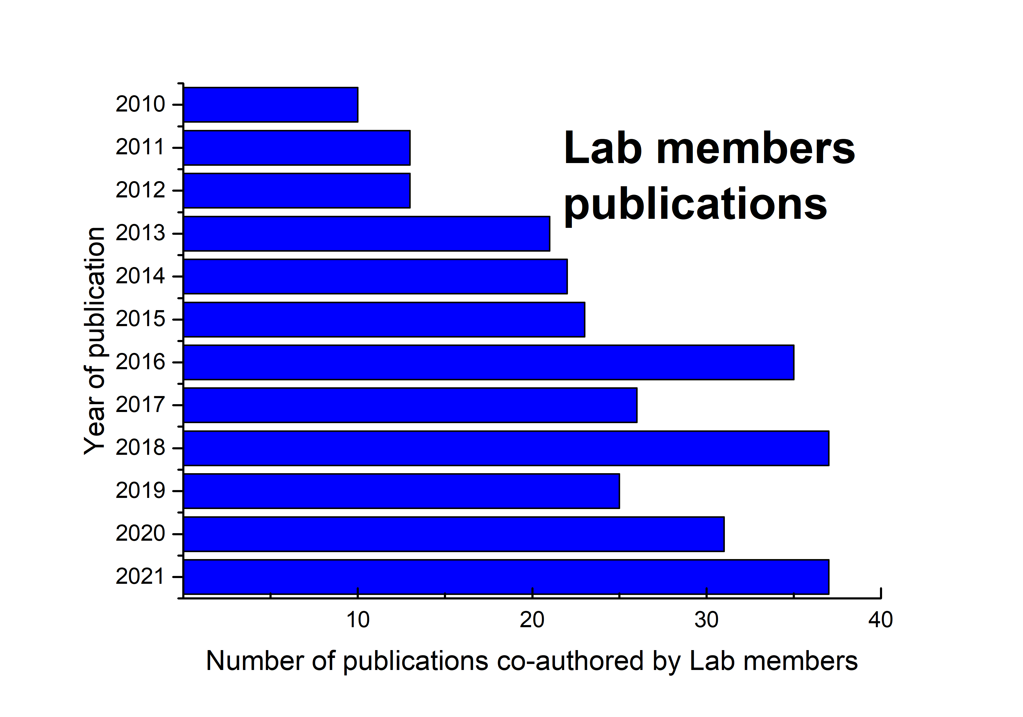
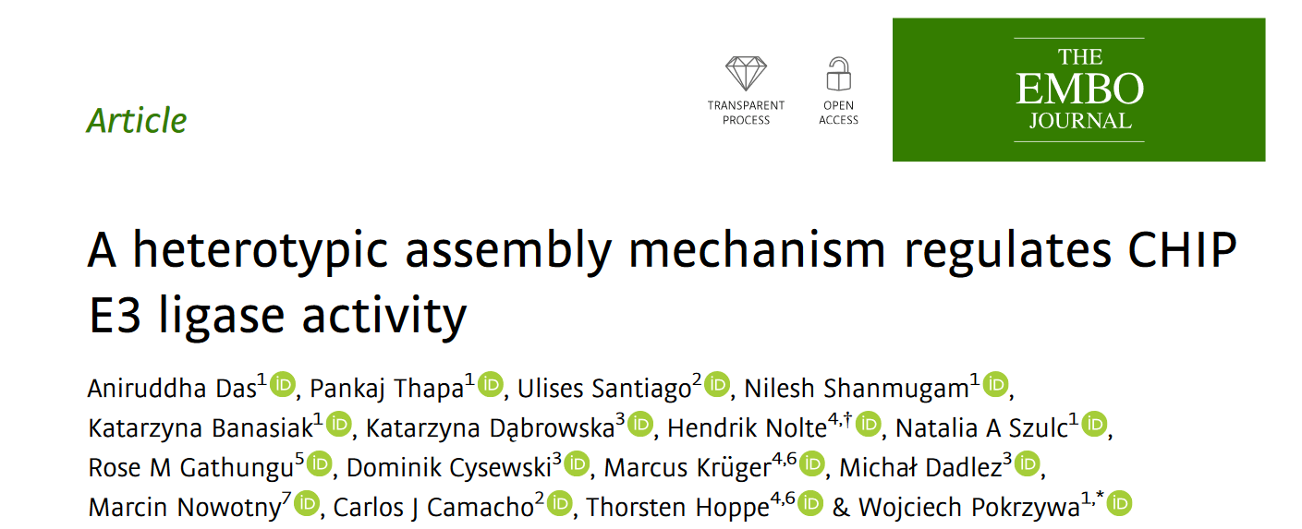
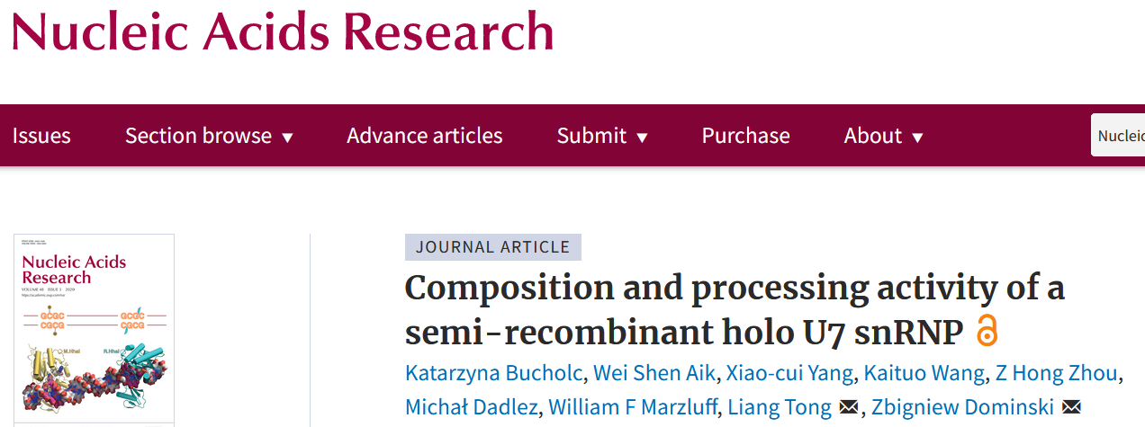
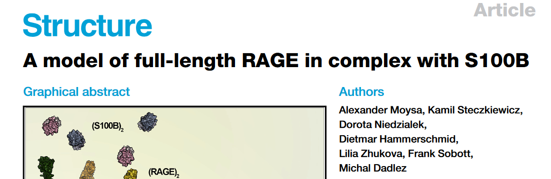
Lab activity in numbers
http://mslab-ibb.pl/en/science/publications
http://mslab-ibb.pl/en/science/collaborators

Slide 4





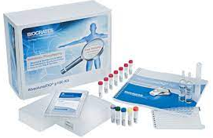
Metabolome quantitation: available LC- and GC-MS methods
Gut microbiome metabolites: SCFAs panel,
TMA-family panel
Medium and long chain fatty acids panel
Neurotransmitters and Amino acids panels
Carnitine total and free fraction
Prenols and dolichols
Drugs and metabolites: Salinomycin, Simvastatin and its metabolites,
Doxorubicin
Asymmetric and symmetric dimethylarginine (ADMA and SDMA)
Plant’s hormones: Jasmonic acid and abscisic acid
Nicotine and its metabolites
Steroids
Vitamins B, C, D3
GC/MS methods: Etanol, Glucose, fructose, saccharose
TEAM-TECH
Core supported
MxP® Quant 500 kit
up to 630 metabolites from 26 biochemical classes quantified from 10 µL sample
study relevant pathways with over 230 sums and ratios
Other small biomolecules based on client’s needs
Development of analytical methods of newly discovered drugs
Global metabolomics
http://mslab-ibb.pl/en/services/quantitative-analysis

Slide 5
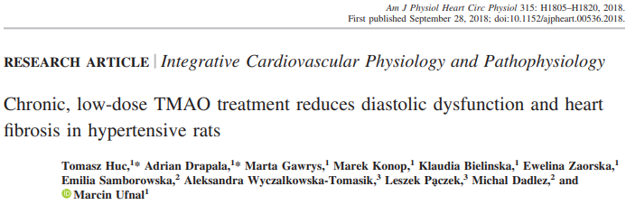
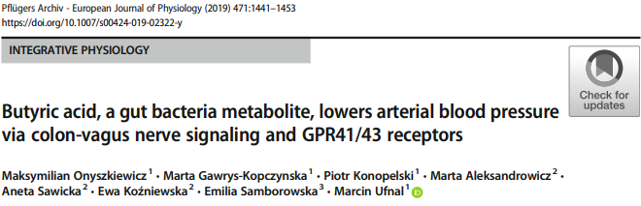
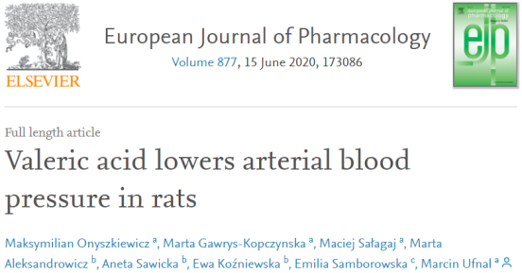
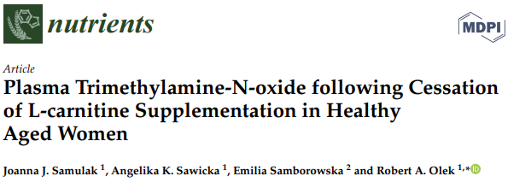
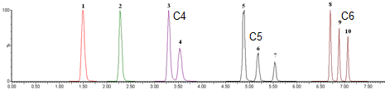
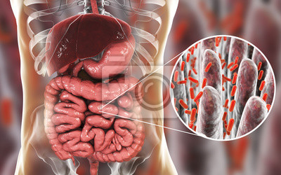
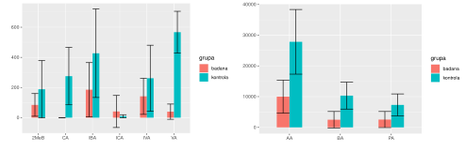


Gut microbiome metabolites
Biological samples: serum, plasma, urine, stool extract, tissue homogenates
Short Chain Fatty Acids panel:
10 acids C2-C6 (LOQ= 0,1μM)
Isomers’ chromatographic separation after derivatization
Trimethylamine panel: TMA, TMAO, betaine, carnitine, choline
Methods application:
Oncology
Gastrology
Microbiology
Cardiology
Alergology
Neurology
Dermatology
Transplantation
Psychiatry
Dentistry
Stool extract analysis of:
Study group (7): children with intestinal inflammations
Control group (10): children without intestinal disorders

Slide 6
Medium and Long Chain Fatty Acids panel
Enables quantification of 14 M/LCFA in blood plasma or human milk
Method validation included:
  Curve linearity and range (1 – 300 µg/mL)
  LOD and LOQ
  Precision (high repeatability and reproducibility)
  Analytes durability
Fast panel analysis – no derivatisation
„Role of mARC-2 in lipogenesis” knockout mice analysis
NIO, Warsaw
Blood
plasma
Liver homogenate
Notes:
heatmapa pokazuje różnice pomiędzy grupą myszy karmioną dwoma różnymi typami karmy, jedną ubogą w nasycone tłuszczone, drugą bogatą w nie, dwa grafy pudełkowe przedstawiające różnice w stężeniu EPA w surowicy tych myszy i ich wątrobie
Te dwa slajdy pokazują metody, które ostatnio cieszą się największym zainteresowaniem.

Slide 7
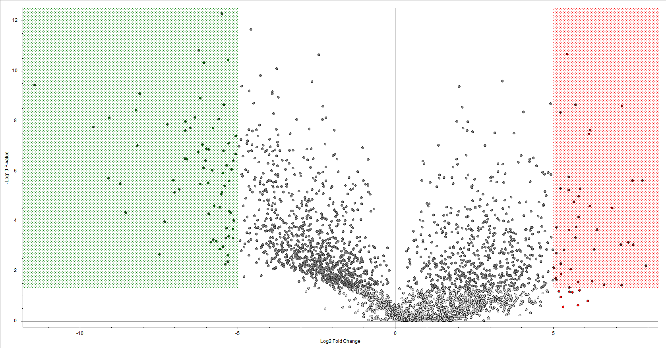
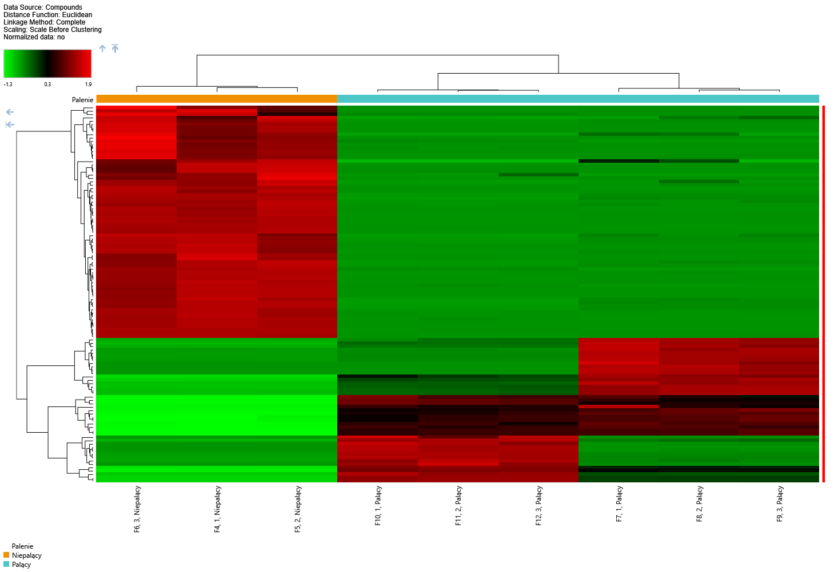
Global metabolomics/lipidomics
Up
Down
Simultanous identification and semi-quantification of vast number of molecules
Various matrices (blood plasma, human milk, cellular extracts, rectal swabs)
Different extraction and LC analysis protocols provide thousands of molecules from different classes
Identification of unknown small molecules
Best approach to find possible differentiating candidate
Non-smokers
Smokers
Notes:
4. Analiza globalna- myślę, że warto to pokazać. Być może kogoś zainteresuje
Info od Mariusza: - na slajdzie mamy volcano plot, umożliwiający szybką analizę statystyczną i wybranie najbardziej różniących próbek, w tym wypadku 60 analitów podwyższonych u palących i 40 obniżonych względem niepalących i te cząsteczki pokazane na heatmapie

Slide 8
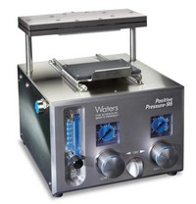
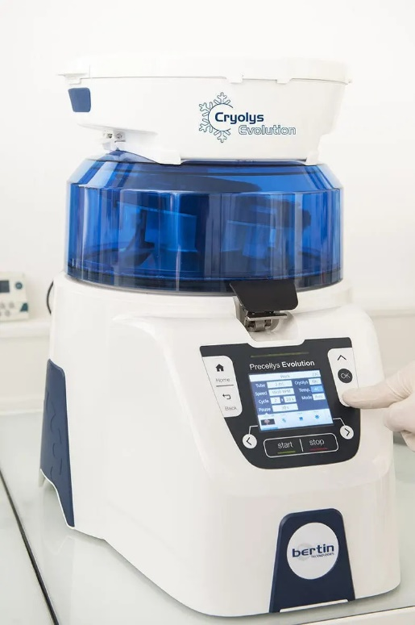
Broad range of analytical matrices and preparation techniques
Liquid samples
Solid samples
Blood samples
  Whole blood
  Plasma
  Serum
Urine samples
Culture media
Mother’s milk
Reaction buffers
Tissue samples
Organ samples
Stool samples
Tumors
Muscles
Adipose
Bone
Brain
Liver
Kidney
Lungs
TEAM-TECH
Core supported
Homogenization
Protein precipitation
Phospholipid depletion
Derivatization
SPE
LLE
LC-MS/MS
Notes:
Biały z niebieskim: Precellys Evolution homogenizer with Cryolys Evolution cooling attachment
Stalowoszary: Waters positive pressure solid phase extraction procesor
SPE – ekstrakcja na fazie stałej – solid phase extraction
LLE –ekstrakcja ciecz-ciecz – liquid-liquid extraction

Slide 9
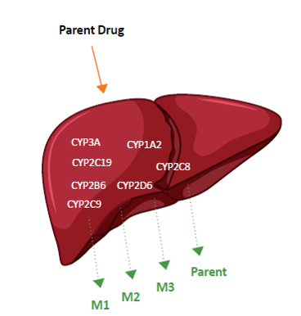
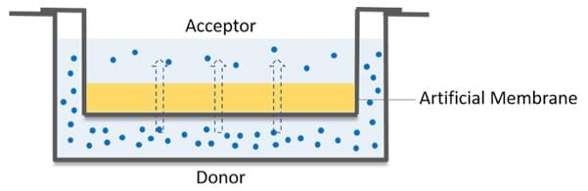
Specialized protocols
β-glucuronidase digestion protocol
Free and total fraction of circulating drug
Microsomal stability assay
PAMPA assay
Chemical stability assay
Assessment of migration through phospholipid bilayer
Assesment of stability at diferent pH and temperature
In vivo assesment of Phase I liver metabolism
Notes:
Protokół badania trwałości na mikrosomach wątrobowych
Frakcja mikrosomalna wątroby zawiera aktywne enzymy z grupy Cytochromu P450
Podczas inkubacji z mikrosomami i substratem energetycznym (NADPH) odtwarzane są in vitro reakcje pierwszej fazy metabolizmu ksenobiotyków
Procedura pozwala min. ocenić in vitro efekt pierwszego przejścia (metabolizm wątrobowy leku od razu po wchłonięciu w układzie pokarmowym) dla nowo zsyntezowanych leków.
Planujemy rozszerzenie tej procedury o badanie inhibicji poszczególnych izoform cytochromu P450 przez testowane API
Protokół PAMPA (Parallel Artificial Membrane Permeability Assay)
do oceny przenikania leków przez podwójne błony lipidowe.
Procedura testowania stabilności chemicznej nowych API (active pharmaceutical ingredient)
Procedura przetestowana w trzech standardowych buforach:
pH 5,2 (bufor z octanu sodowego);
pH 7,4 (sól fizjologiczna z buforem fosforanowym PBS)
pH 9,2 (bufor glicynowy).
W prosty sposób możemy przystosować procedurę do dowolnego buforu i wykonać w szerokim zakresie temperatur
β-glukuronidaza
II faza metabolizmu to min sprzęganie z kwasem glukuronowym
Frakcja wolna – lek w takiej formie jak został podany
Frakcja związana – lek po sprzęgnięciu z kwasem glukuronowym
Frakcja całkowita – suma dwóch poprzednich
Bez trawienia oznaczamy frakcję wolną, po trawieniu glukuronidazą frakcję całkowitą. Frakcję związaną wyliczamy z różnicy.

Slide 10

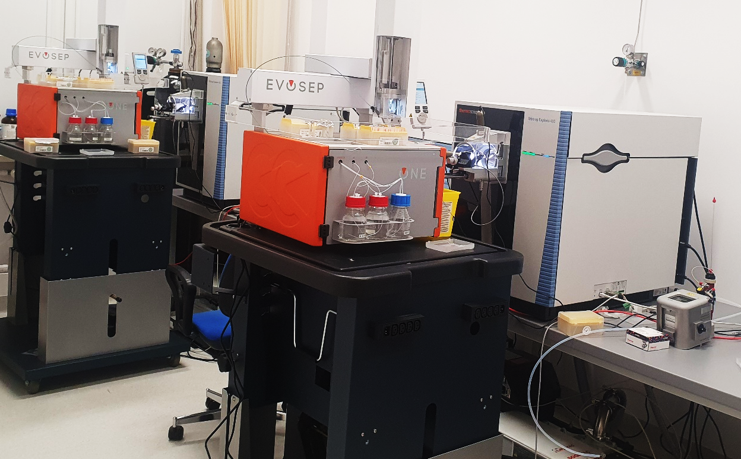
Proteomics: most up-to date equipment
Two Evosep One/Exploris 480 systems available at present
(instal 2021/2022)
Better results in shorter time, high throughput, most sophisticated analytical schemes available
Multiple acquisition methods for typical samples
or tailored for specific needs
Almost no queue (before even 3 month waiting time!)
http://mslab-ibb.pl/en/equipment
Since March 2021:
462 analysis orders for
Exploris system (total 885)
7 252 samples
10 896 separate LC-MS runs
HeLa digest
100 ng
500 ng
nanoLC / QExactive Evosep One / Exploris 480

Slide 11
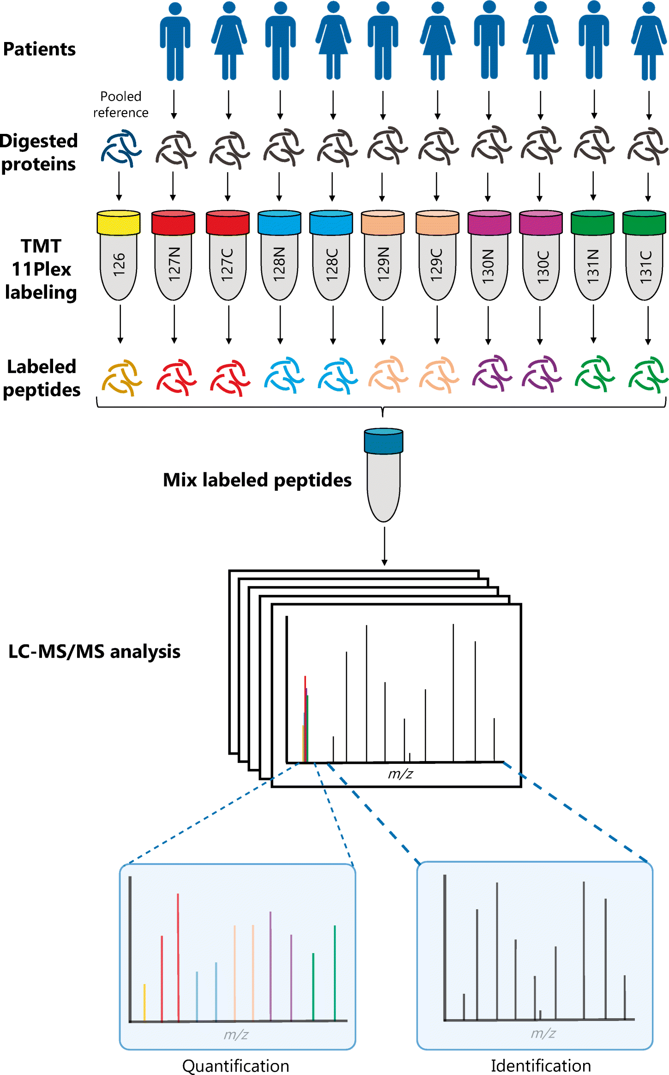
Data acquisition types in proteomics
TMT 18 samples in parallell
Data-Dependent Acquisition (DDA)
Data-Independent Acquisition (DIA=SWATH)
Targeted analysis
(MRM/PRM)
Preparation
List of m/z windows
List of precursors + internal standards
Single precursor
Multiple precursors
Single precursor
MS
(Full scan)
Intensity
Intensity
Intensity
m/z
m/z
m/z
Light
Intensity
Intensity
Intensity
MS/MS
(MS2)
Multiple
m/z
windows
m/z
Top N
m/z
m/z
Heavy
Intensity
Intensity
Intensity
m/z
m/z
m/z
TEAM-TECH support

Slide 12
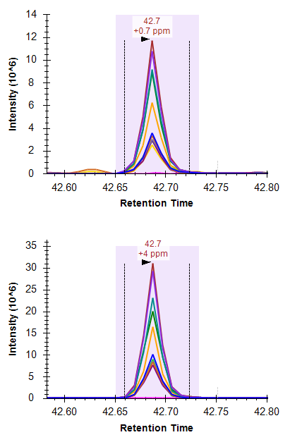
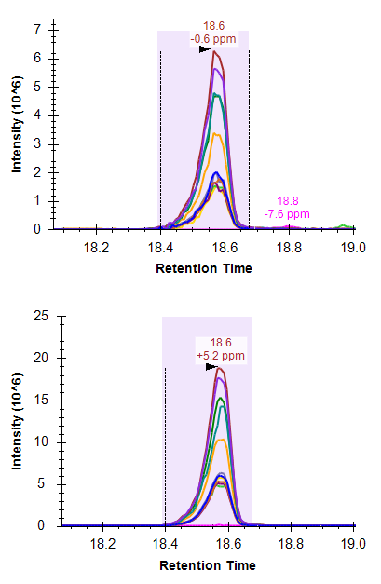
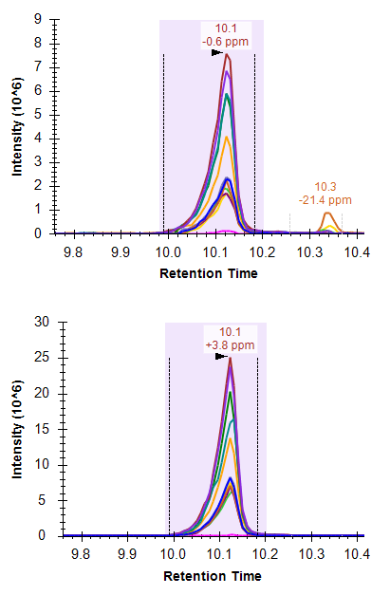
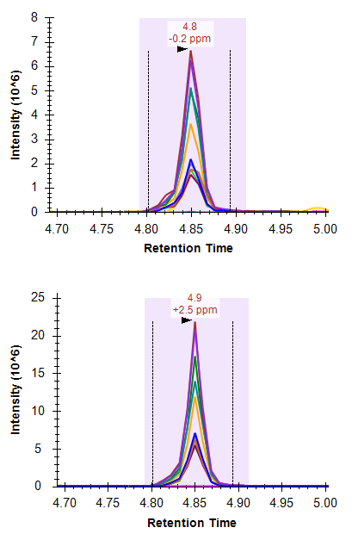
PRM analysis using short LC-MS gradients
Quantitative analysis of MARC1 and MARC2 proteins in human cell line
44 min
30 SPD
20 min
60 SPD
11.5 min
100 SPD
5.6 min
200 SPD
ENDO
IS
7x shorter LC-MS analysis time
2x cost reduction (covering sample preparation, LC-MS, data analysis)
not compromising on the quality of the results

Slide 13
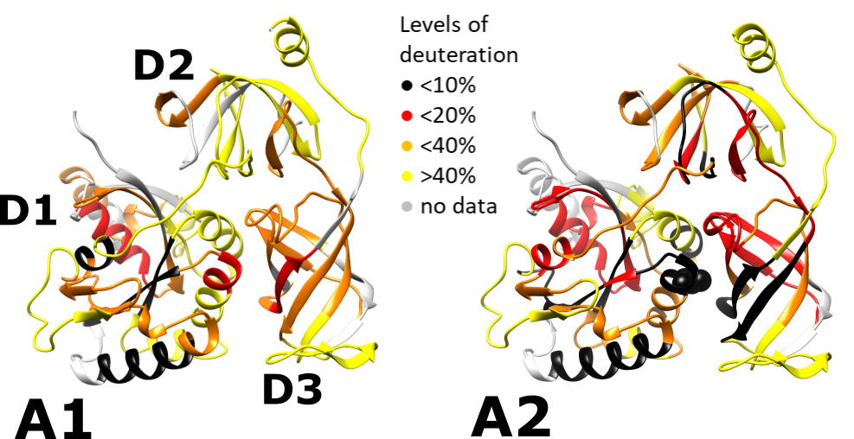
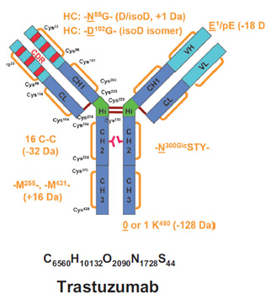
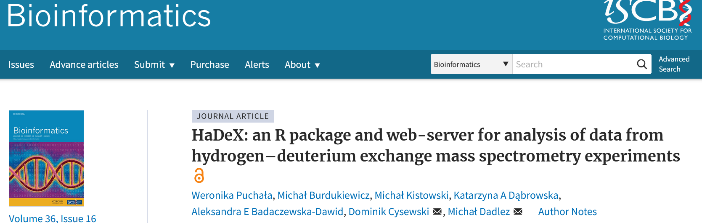
Structural MS – protein dynamics axis by monitoring hydrogen deuterium exchange
– canonical translation elongation factor 1 (eEF1A) high dynamics of A1 variant as compared to A2
D2
D3
Experiments carried out by Katarzyna Dąbrowska and Vyacheslav Shalak (IMBG NAS, Kyiv, Ukraine)
Exchange levels after 1 min deuteration in GDP-eEF1A1 & A2 overlaid on their Alpha2Fold prediction
Notes:
Cys 234 essental for oligomeirsation: Liu acta Bioch Bioph 2015 (47) 1011.
A2 crystallized as a dimer Crepin, Shalak et al. Nusl Acids Res 2014, 42, 12939; Carriles, Gago, Mills, Hermoso 2020 ChemBioChem bez nr stron.
eEF1A1 zrobione cryoEM w kompleksie z rybosomem w pdb jako podjednostka struktury 6zmo: DOI: 10.1126/science.abc8665
Ejiri S (2002) Moonlighting functions of polypeptide elongation factor 1: from
actin bundling to zinc finger protein R1-associated nuclear localization. Biosci
Biotechnol Biochem 66: 1–21
The
near-ubiquitous form, eEF1A1, is expressed in all tissues
throughout development but is absent in adult muscle and heart
[2,3]. The latter tissues express instead eEF1A2 as do certain other
cell types including, notably, large motor neurons, islet cells in the
pancreas and enteroendocrine cells in the gut

Slide 14
Mass Spectrometry Laboratory
Group leaders:
Dominik Domański, PhD
Aleksandra Wysłouch-Cieszyńska, PhD
Proteomics team
Bianka Świderska, M.Sc.
Magda Bakun, M.Sc.
Michał Kistowski, M.Sc.
Agata Malinowska, PhD
Jacek Olędzki, M.Sc.
Ewa Sitkiewicz, PhD
Agnieszka Stewart, M. Sc.
Marta Żurawska, PhD student
Metabolomics team
Emilia Samborowska, MD, M.Sc.
Radosław Jaźwiec, PhD student
Mariusz Radkiewicz, M.Sc.
Jakub Karczmarski, PhD
Structural MS
Katarzyna Dąbrowska, PhD student
Weronika Puchała, PhD student
Lilia Zhukova
Alumni: Postdocs: Aleksander Moysa; Magdalena Kulma, Magdalena Kaus-Drobek; PhD: Agnieszka Fatalska, Magdalena Richter, Aiswarya Premchandar, Krzysztof Tarnowski, Aleksandra Skrajna, Aleksandra Kacprzyk-Stokowiec, Kaja Przygońska, Katarzyna Bucholc-Bąk, Janusz Dębski, Anna Perzanowska, Anna Kupniewska, Włodzimierz Tszyrsznic, Magda Polakowska, Aleksandra Robak,
Proteomics:
1a Global qualitative analyses, including PTMs
1b Differential quantitative analyses
2. Targeted (protein/peptide panel quantitation)
3. Structural Mass Spectrometry
Metabolomics:
4. Targeted (small molecule panel quantitation)
5. Global metabolomics, lipidomics, etc.
Support from the Foundation for Polish Science,
NCN, NCBiR, MNiSzW is kindly acknowledged!

